Slide 1

Finpro Bank
Data Architecture, Implementation and Recommendations

Slide 2
Outline
Introduction
Data acquisition and cleaning
Database design and setup
Evaluation and interpretation
Data integration and security
Data reporting
General handover documentation
Insights and recommendations
Summary
Appendix

Slide 3
Introduction

Slide 4
Purpose of the presentation
The purpose of this presentation is to provide a comprehensive overview of FinPro Bank’s data management strategy. We will explore how an end-to-end data pipeline enhances decision-making, customer satisfaction, and fraud detection. This session will highlight the tools and technologies used, from data preparation in Excel to business intelligence insights in Tableau, demonstrating how FinPro Bank optimizes its data operations for strategic growth.

Slide 5
Summary of work done on the project
In this project, we have built a seamless data management system to drive informed decision-making at FinPro Bank. Our work began with cleaning and preparing raw data in Excel to ensure accuracy and usability. We then organized the data within a MySQL relational database, allowing for structured storage and retrieval. To enable deeper analysis, we transferred key datasets into a Postgres data warehouse, ensuring data integrity and performance. Finally, we transformed the data into actionable insights by creating strategic dashboards in Tableau, enabling stakeholders to track key performance indicators, customer trends, and fraud patterns in real time.

Slide 6
Data acquisition and cleaning

Slide 7
Data cleaning documentation (1 of 3)
Customer Data Sheet provides detailed information about individual customers, including their names, contact details, demographics, account details, and more.
Transaction Data Sheet records the transactional history of customers, encompassing details like transaction dates, types, amounts, and locations.
Account Type Sheet categorizes different account types offered by the bank.
Countries Sheet lists various countries and their corresponding codes and continents.
US_Cities Sheet provides a list of US cities and their associated codes.

Slide 8
Data cleaning documentation (2 of 3)
Data Import & Initial Review
Imported raw data from multiple sources into Excel.
Conducted an initial scan to identify inconsistencies, missing values, and potential outliers.
Handling Missing Values
Used filtering and conditional formatting to detect missing data.
Filled missing numerical values using the mean or median where appropriate.
For categorical data, used the mode or forward-fill/backward-fill techniques to maintain consistency.
Removed records with excessive missing values if they could not be reasonably imputed.
Removing Duplicates
Used the Remove Duplicates feature to eliminate redundant records.
Verified duplicate entries by checking unique identifiers such as customer ID or transaction ID before deletion.

Slide 9
Data cleaning documentation (3 of 3)
= DATEDIF([DateOfBirth], TODAY(), "Y")
= TEXT([TransactionDate], "MMMM")
= IF(A2>=10000, "High Balance", IF(A2>=5000, "Medium Balance", "Low Balance"))

Slide 10
Analysis and visualization using MS Excel (1 of 2)
1. Customer Metrics
Customer Retention Rate = (Customers at End of Period – New Customers) / Customers at Start of Period × 100 Measures how well the bank retains existing customers.
Customer Lifetime Value (CLV) = Average Transaction Value × Purchase Frequency × Customer Lifespan Estimates the total revenue expected from a customer over their banking relationship.
2. Fraud Detection KPIs
Suspicious Transaction Percentage = (Flagged Transactions / Total Transactions) × 100 Monitors anomalies in transaction behavior.
Unusual Login Activity = Count of logins from new locations or devices. Identifies potential account breaches.

Slide 11
Analysis and visualization using MS Excel (2 of 2)
Regular Data Cleaning
Check for missing values and apply the same imputation techniques used previously (e.g., mean/median for numerical values, mode for categorical values).
Remove duplicates using Excel’s Remove Duplicates tool.
Identify outliers using statistical functions such as STDEV, QUARTILE, or IQR method.
Update Relational Database (MySQL)
Append new transaction and customer data to the MySQL database.
Validate data integrity using SQL queries (e.g., checking for null values or inconsistencies in primary keys).
Optimize queries to improve performance and retrieval times.

Slide 12
Database design and setup

Slide 13
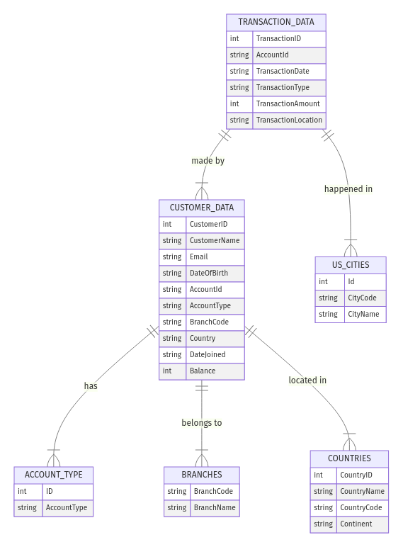
Entity relationship diagram (ERD) (1 of 3)

Slide 14
Entity relationship diagram (ERD) (2 of 3)
The finpro database appears to be designed for a financial institution, likely a banking system that manages customer accounts, transactions, branches, and locations.
ACCOUNT_TYPE (Stores different types of accounts)
ID (int) → Unique identifier for the account type
AccountType (varchar, Unique) → Describes the type of account (e.g., Savings, Checking)

Slide 15
Entity relationship diagram (ERD) (3 of 3)
Customer-Centric Approach:
The customer_data table is at the center, linking account type, branches, and countries.
This makes it easy to track customer behavior and financial history.
Transaction Tracking for Security & Compliance:
Every transaction is logged with amount, type, and location.
Helps in detecting fraudulent activities (e.g., sudden withdrawals in different cities).
Geographical Distribution:
Countries and cities allow for international operations.
Useful for regional reporting and financial regulations compliance.
Branch-Based Banking:
Each customer is linked to a branch, ensuring better customer service.
Helps in branch-level revenue tracking and performance analysis.
Data Integrity & Relationships:
Foreign key constraints ensure data consistency.
Unique constraints prevent duplicate accounts, branches, and locations.

Slide 16
Table structure design
ACCOUNT_TYPE (Stores different types of accounts)
Primary Key: AccountType
BRANCHES (Stores branch details)
Primary Key: BranchCode
COUNTRIES (Stores country details)
Primary Key: CountryName
CUSTOMER_DATA (Stores customer information)
Primary Key: AccountId
TRANSACTION_DATA (Stores transaction details)
Foreign Key: AccountId

Slide 17
OLAP schema (1 of 3)
The database follows a Snowflake Schema rather than a Star Schema.
A central fact table connects to normalized dimension tables, which may be further broken down.
Dimension tables are normalized to remove redundancy.
Advantage: Saves storage space, avoids duplicate data, and ensures better data integrity.
Disadvantage: Queries require more joins, making them slightly slower.

Slide 18
OLAP schema (2 of 3)
Transaction Data (Fact Table)
Role:
This is the central table that records all financial transactions.
Stores measurable values (e.g., transaction amount, type, and date).
Connects to multiple dimension tables for detailed analysis.
Dimension Tables
Customer Dimension
Account Type Dimension
Branch Dimension
Geographical Dimension
Transaction Location Dimension

Slide 19
OLAP schema (3 of 3)

Slide 20
Evaluation and interpretation

Slide 21
Documenting SQL queries and scripts (1 of 4)
CREATE TABLE transaction_data ( TransactionID INT AUTO_INCREMENT PRIMARY KEY, AccountId VARCHAR(100), TransactionDate DATETIME, TransactionType VARCHAR(50), TransactionAmount DECIMAL(10,2), TransactionLocation VARCHAR(100), FOREIGN KEY (AccountId) REFERENCES customer_data(AccountId), FOREIGN KEY (TransactionLocation) REFERENCES us_cities(CityName));
CREATE TABLE transaction_summary ( MonthYear VARCHAR(7), -- Example: '2024-01' AccountId VARCHAR(100), TotalTransactions INT, TotalAmount DECIMAL(12,2), AverageTransaction DECIMAL(10,2), PRIMARY KEY (MonthYear, AccountId));

Slide 22
Documenting SQL queries and scripts (2 of 4)
INSERT INTO customer_data (CustomerName, Email, DateOfBirth, AccountId, AccountType, BranchCode, Country, DateJoined, Balance)VALUES ('John Doe', 'johndoe@email.com', '1990-05-20', 'ACC98765', 'Savings', 'BR001', 'USA', NOW(), 5000.00);
UPDATE customer_data SET Balance = Balance - 300.00 WHERE AccountId = 'ACC98765';

Slide 23
Documenting SQL queries and scripts (3 of 4)
SELECT DATE_FORMAT(TransactionDate, '%Y-%m') AS Month, AccountId, SUM(TransactionAmount) AS TotalAmount, COUNT(TransactionID) AS TotalTransactionsFROM transaction_dataGROUP BY ROLLUP (Month, AccountId);
SELECT a.AccountType, c.Country, SUM(t.TransactionAmount) AS TotalRevenueFROM transaction_data tJOIN customer_data c ON t.AccountId = c.AccountIdJOIN account_type a ON c.AccountType = a.AccountTypeGROUP BY CUBE (a.AccountType, c.Country);

Slide 24
Documenting SQL queries and scripts (4 of 4)
SELECT AccountId, CustomerName, BalanceFROM customer_dataORDER BY Balance DESC;
SELECT c.CustomerName, SUM(CASE WHEN t.TransactionType = 'Deposit' THEN 1 ELSE 0 END) AS TotalDeposits, SUM(CASE WHEN t.TransactionType = 'Withdrawal' THEN 1 ELSE 0 END) AS TotalWithdrawalsFROM transaction_data tJOIN customer_data c ON t.AccountId = c.AccountIdGROUP BY c.CustomerNameORDER BY TotalDeposits DESC;

Slide 25
Inferences (1 of 2)
The OLTP analysis queries provide critical insights into customer behavior, account balances, and transaction patterns.
OLTP Analysis Query 1: Closing Balance Per Account
SELECT AccountId, CustomerName, Balance
FROM customer_data
ORDER BY Balance DESC;
Purpose:
Retrieves the current balance per account.
Identifies customers with high or low balances for risk assessment and personalized offers.

Slide 26
Inferences (2 of 2)
Monthly Transaction Summary
SELECT DATE_FORMAT(TransactionDate, '%Y-%m') AS Month, AccountId, SUM(TransactionAmount) AS TotalAmount, COUNT(TransactionID) AS TotalTransactionsFROM transaction_dataGROUP BY ROLLUP (Month, AccountId);
Purpose:
Summarizes total transactions per account per month.
Uses ROLLUP to compute subtotals at multiple levels (monthly totals and individual customer totals).

Slide 27
Data integration and security

Slide 28

Data integration recommendations (1 of 3)
Customer Data and Transactions (Customer Data Sheet & Transaction Data Sheet)
Integration Requirement:
The AccountId field in the Customer Data Sheet links to the Transaction Data Sheet to track customer transactions.
TransactionDate should align with DateJoined to prevent transactions before the customer joined.
Justification:
Ensures accurate transaction history per customer.
Validates transactions by linking them to active customers only.
Helps in fraud detection by ensuring accounts aren't used before activation.

Slide 29
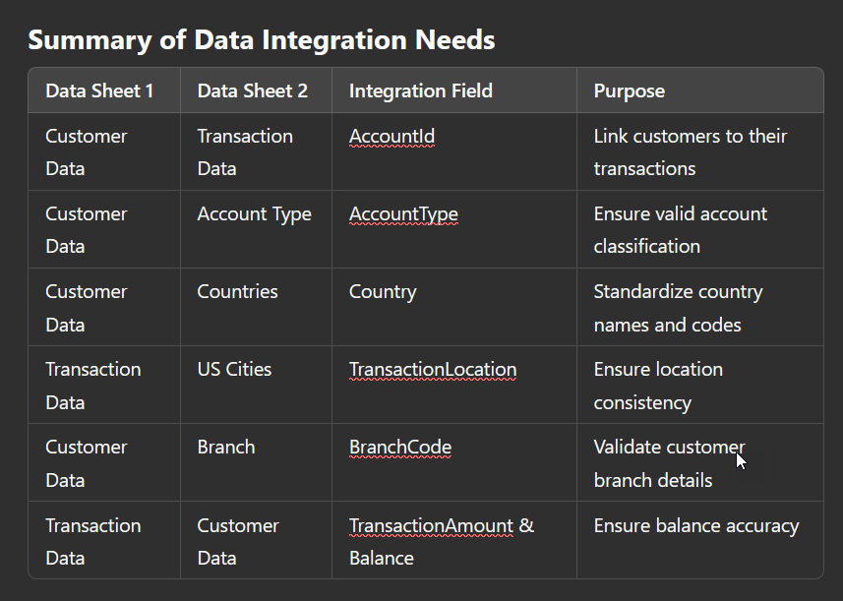
Data integration recommendations (2 of 3)

Slide 30
Data integration recommendations (3 of 3)
ETL (Extract, Transform, Load)
Implementation Steps:
Extract: Pull data from multiple sources (Excel sheets, databases, APIs).
Transform:
Standardize country names (e.g., "US" → "United States").
Clean invalid emails and format dates correctly.
Map transaction locations to standardized city codes.
Load: Insert the cleaned and structured data into the Snowflake Schema database.
Recommended Tools:
Informatica PowerCenter, Talend, Apache NiFi, or AWS Glue for ETL processing

Slide 31
Security documentation (1 of 3)
Role-Based Access Control (RBAC) is a security model that restricts system access based on user roles within an organization. Each role is assigned specific permissions that define what actions can be performed and which data can be accessed.
For FinPro Bank, the fin_manager (Finance Manager) role is responsible for overseeing financial operations, transaction approvals, and financial reporting. Given the sensitivity of financial data, RBAC ensures that the fin_manager can only access the information necessary for their responsibilities while preventing unauthorized access to critical banking systems.

Slide 32
Security documentation (2 of 3)
Best Practices for Column-Level Encryption
Identify Sensitive Data for Encryption
Choose an Encryption Method
Implement Column-Level Encryption Using AES-256
Apply Role-Based Restrictions to Encrypted Data
Audit & Monitor Encrypted Data Access

Slide 33
Security documentation (3 of 3)
Step-by-Step Procedure for Assigning Table-Specific Privileges
Step 1: Create the fin_manager role
Step 2: Assign the Role to Users
Step 3: Grant Read-Only Access to Financial Data
Step 4: Grant Transaction Approval Privileges
Step 5: Restrict Access to Personal Customer Data
Step 6: Prevent Unauthorized Modifications
Step 7: Enable Logging & Auditing
Step 8: Verify Privileges

Slide 34
Data reporting

Slide 35
Report specifications (1 of 6)
1. Customer Data Sheet
Description: Contains details about individual bank customers, including personal information, account details, and demographic data.
Relevance: Used to analyze customer demographics, account types, and banking behavior. It helps in customer segmentation, retention analysis, and fraud detection.
2. Transaction Data Sheet
Description: Records all banking transactions, including deposits, withdrawals, and transfers, with details on transaction amounts, dates, and locations.
Relevance: Essential for financial reporting, trend analysis, fraud detection, and identifying high-value transactions.

Slide 36
Report specifications (2 of 6)
3. Account Type Sheet
Description: Provides a list of different types of bank accounts available, such as Savings and Checking accounts.
Relevance: Used to classify and analyze customer accounts, track product popularity, and assess account-specific trends.
4. Countries Sheet
Description: Lists countries where the bank operates, including country names, codes, and their respective continents.
Relevance: Helps standardize country data for consistency in reporting, regional analysis, and compliance tracking.

Slide 37
Report specifications (3 of 6)
5. US Cities Sheet
Description: Contains a list of US cities and their corresponding city codes used in bank records.
Relevance: Supports regional transaction analysis, customer location tracking, and branch performance assessments within the US.
6. Branch Sheet
Description: Contains details of bank branches, including their unique branch codes and names.
Relevance: Used to analyze branch-specific transactions, performance, and customer distribution.

Slide 38
Report specifications (4 of 6)
Date Range Filter
Transaction Type Filter

Slide 39
Report specifications (5 of 6)
c) Account Type Filter
d) Branch Filter

Slide 40
Report specifications (6 of 6)
e) Country Filter
f) High-Value Transactions Filter

Slide 41
Performance analysis guidelines (1 of 3)
Comprehensive List of Metrics/KPIs for Performance Analysis
Financial Performance Metrics
Customer Experience & Retention Metrics
Operational Efficiency Metrics
Security & Compliance Metrics
Digital Banking & IT Performance Metrics
Risk Management & Fraud Prevention Metrics
Employee Performance & Workforce Metrics

Slide 42
Performance analysis guidelines (2 of 3)
Dashboard Design
Layout: Multi-section design with financial, operational, customer, and security metrics.
Visuals: Interactive charts, KPI scorecards, and trend analysis graphs.
Filters: Date range, branch selection, account type, and transaction type.
Data Sources: Transaction logs, customer data, financial reports, and security logs.
Key Insights Generated
Profitability Trends: Identifies revenue drivers by analyzing Net Interest Margin (NIM), ROA, and ROE.
Customer Satisfaction & Retention: Pinpoints retention risks via NPS scores, complaint analysis, and churn rate.

Slide 43
Performance analysis guidelines (3 of 3)
Maintaining and Updating FinPro Bank’s Performance Dashboard
Step 1: Refresh Data Regularly
Step 2: Add or Remove KPIs Based on Business Needs
Step 3: Optimize Dashboard Performance
Step 4: Ensure Data Accuracy & Security Compliance

Slide 44
General handover documentation

Slide 45
Role and key responsibilities
As a Data Manager at FinPro Bank, my primary role was to design, implement, and manage the bank’s data architecture, ensuring seamless data integration, processing, and reporting. My responsibilities covered the entire data pipeline, from raw data acquisition to the creation of insightful business intelligence dashboards.
Key Responsibilities and Contributions
Data Acquisition and Cleaning
Database Design and Management
Data Warehousing and Optimization
Business Intelligence and Reporting
Security and Compliance
Handover Documentation and Training

Slide 46
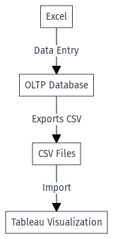
System architecture diagram

Slide 47
Key challenges and resolutions
Data Inconsistencies Across Multiple Sources
Issue:
Different data sources had inconsistent formats, such as varying country codes ("US" vs. "United States"), date formats, and missing account types.
Transaction records contained incorrect or duplicate customer information.
Resolution:
Standardized data formats using Excel functions (e.g., TEXT, FIND & REPLACE, and IFERROR). Used SQL queries in MySQL to clean and normalize data before storing it in the database. Implemented data validation rules to enforce consistency during data entry.

Slide 48
Insights and recommendations

Slide 49
Insights and recommendations
1. Data Quality is the Foundation of Reliable Analytics
Insight:
Poor data quality leads to incorrect analysis, misleading reports, and flawed decision-making. Issues such as missing values, inconsistent formats, and duplicates can significantly impact the bank’s operations.
2. Optimized Data Processing Improves System Performance
Insight:
Large volumes of transactional data can slow down queries and dashboards, leading to delays in generating insights for bank management.
3. Effective Documentation and Knowledge Sharing Ensure Long-Term Success
Insight:
A well-documented system is crucial for future updates, troubleshooting, and onboarding new team members. Without proper documentation, resolving issues or making enhancements becomes time-consuming and prone to errors.

Slide 50
Summary

Slide 51

Appendix

Slide 52
Appendix #
Include any relevant additional charts, worksheets, or tables that you may have created during the analysis phase
You can provide links to public tableau reports and dashboards you have prepared

